Slide 1
Deep Learning Part II ch 21 Russell and Norvig
Including Slides by
Mark Hasegawa-Johnson, 4/2019
Svetlana Lazebnik, 10/2016
From UIUC CS 440

Slide 2
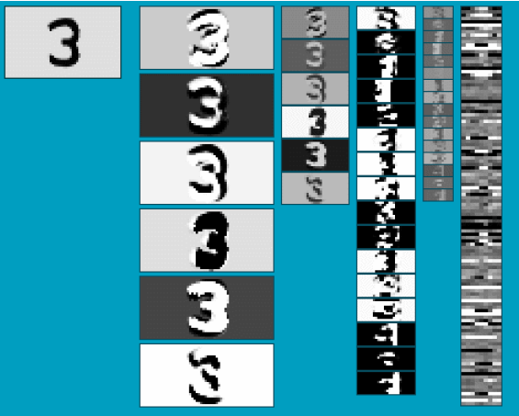
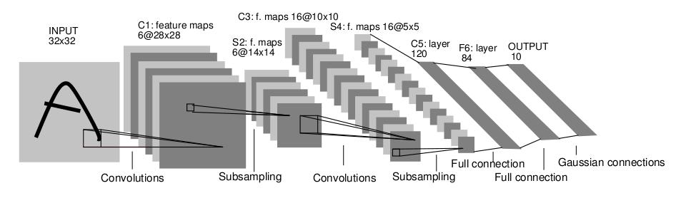
Convolutional Neural Networks
Neural network with specialized connectivity structure
Stack multiple stages of feature extractors
Higher stages compute more global, more invariant features
Classification layer at the end
Y. LeCun, L. Bottou, Y. Bengio, and P. Haffner, Gradient-based learning applied to document recognition, Proc. IEEE 86(11): 2278–2324, 1998.

Slide 3
21.3 Convolutional Networks
We should construct the first hidden layer so that each hidden unit receives input from only a small, local region of the image.
This kills two birds with one stone. First, it respects adjacency, at least locally. Second, it cuts down the number of weights: if each local region has l ≪ n pixels, then there will be l*n ≪ n² weights in all.
Another important property of images: roughly speaking, anything that is detectable in one small, local region of the image—perhaps an eye or a blade of grass—would look the same if it appeared in another small, local region of the image.
In other words, we expect image data to exhibit approximate spatial invariance, at least at small to moderate scales.
Notes:
other (Figure 21.1(a) ). This significantly limits the expressive power of such models. They can represent only linear functions and boundaries in the input space, whereas most real-world concepts are far more complex.

Slide 4
Local Invariance
Local spatial invariance can be achieved by constraining the l weights connecting a local region to a unit in the hidden layer to be the same for each hidden unit. (That is, for hidden
units i and j, the weights w_{1,i} , ... ,w_{l,i} are the same as w_{1,j}, ... ,w_{l,j} ) This makes the hidden
units into feature detectors that detect the same feature wherever it appear in the image.
Typically, we want the first hidden layer to detect many kinds of features, not just one; so for each local image region we might have d hidden units with d distinct sets of weights.
This means that there are dl weights in all—a number that is not only far smaller than n² ,but is actually independent of n, the image size. Thus, by injecting some prior knowledge, namely, knowledge of adjacency and spatial invariance—we can develop models that have far fewer parameters and can learn much more quickly.
Notes:
other (Figure 21.1(a) ). This significantly limits the expressive power of such models. They can represent only linear functions and boundaries in the input space, whereas most real-world concepts are far more complex.

Slide 5
Convolutional Neural Network
A convolutional neural network (CNN) is one that contains spatially local connections, at least in the early layers, and has patterns of weights that are replicated across the units in each layer.
A pattern of weights that is replicated across multiple local regions is called a kernel and the process of applying the kernel to the pixels of the image (or to spatially organized units in a subsequent layer) is called convolution.
Kernels and convolutions easy to illustrate in one dimension rather than two or more, so we will assume an input vector x of size n, corresponding to n pixels in a one-dimensional image, and a vector kernel k of size l. (assume that l is an odd number.) All the ideas carry over straightforwardly to higher-dimensional cases.
Notes:
other (Figure 21.1(a) ). This significantly limits the expressive power of such models. They can represent only linear functions and boundaries in the input space, whereas most real-world concepts are far more complex.

Slide 6
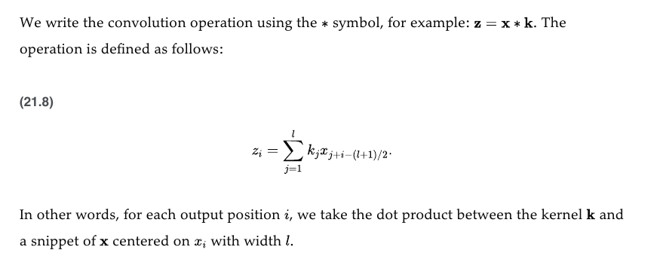
Convolutional Neural Network
Notes:
other (Figure 21.1(a) ). This significantly limits the expressive power of such models. They can represent only linear functions and boundaries in the input space, whereas most real-world concepts are far more complex.

Slide 7
Convolutional Neural Network
The process is illustrated in Figure 21.4 for a kernel vector [+1,−1,+1], which detects a darker point in the 1D image.
Notice that in this example the pixels on which the kernels are centered are separated by a distance of 2 pixels; we say the kernel is applied with a stride s = 2. Notice that the output layer has fewer pixels: because of the stride, the number of pixels is reduced from n to roughly n/s
Edge of the image: in Figure 21.4 the convolution stops at the edges of the image, but one can also pad the input with extra pixels (either zeroes or copies of the outer pixels) so that the kernel can be applied exactly ⌊n/s⌋ times. For small kernels, we typically use s = 1, so the output has the same dimensions as the image (see Figure 21.5 ).
Notes:
other (Figure 21.1(a) ). This significantly limits the expressive power of such models. They can represent only linear functions and boundaries in the input space, whereas most real-world concepts are far more complex.

Slide 8
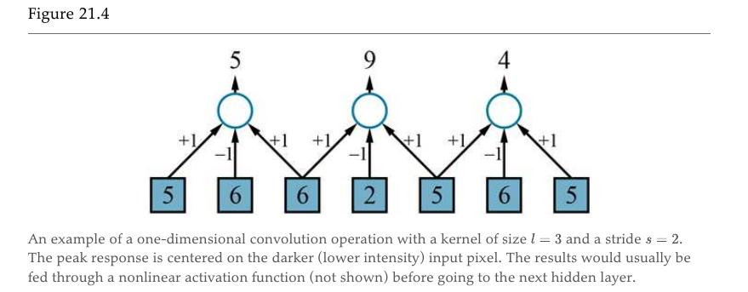
Convolutional Neural Network
The process is illustrated in Figure 21.4 for a kernel vector [+1,−1,+1], which detects a darker point in the 1D image.
Notes:
other (Figure 21.1(a) ). This significantly limits the expressive power of such models. They can represent only linear functions and boundaries in the input space, whereas most real-world concepts are far more complex.

Slide 9
Convolutional Neural Network
Notice that in the previous example the pixels on which the kernels are centered are separated by a distance of 2 pixels; we say the kernel is applied with a stride s = 2. Notice that the output layer has fewer pixels: because of the stride, the number of pixels is reduced from n to roughly n/s
Edge of the image: in Figure 21.4 the convolution stops at the edges of the image, but one can also pad the input with extra pixels (either zeroes or copies of the outer pixels) so that the kernel can be applied exactly ⌊n/s⌋ times. For small kernels, we typically use s = 1, so the output has the same dimensions as the image (see Figure 21.5 ).
Notes:
other (Figure 21.1(a) ). This significantly limits the expressive power of such models. They can represent only linear functions and boundaries in the input space, whereas most real-world concepts are far more complex.

Slide 10
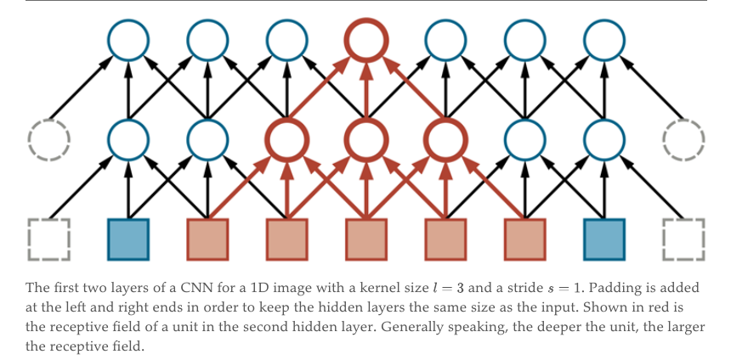
Convolutional Neural Network
the kernel can be applied exactly ⌊n/s⌋ times. For small kernels, we typically use s = 1, so the output has the same dimensions as the image (see Figure below ).
Notes:
other (Figure 21.1(a) ). This significantly limits the expressive power of such models. They can represent only linear functions and boundaries in the input space, whereas most real-world concepts are far more complex.

Slide 11
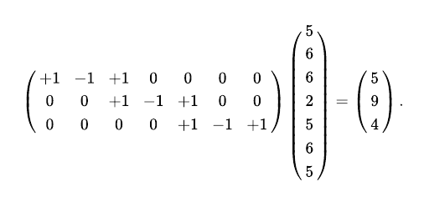
Convolutional Neural Network
Notes:
other (Figure 21.1(a) ). This significantly limits the expressive power of such models. They can represent only linear functions and boundaries in the input space, whereas most real-world concepts are far more complex.

Slide 12

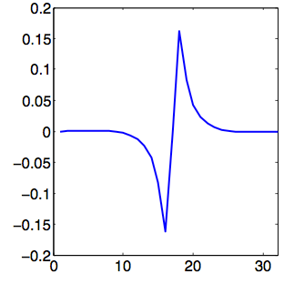
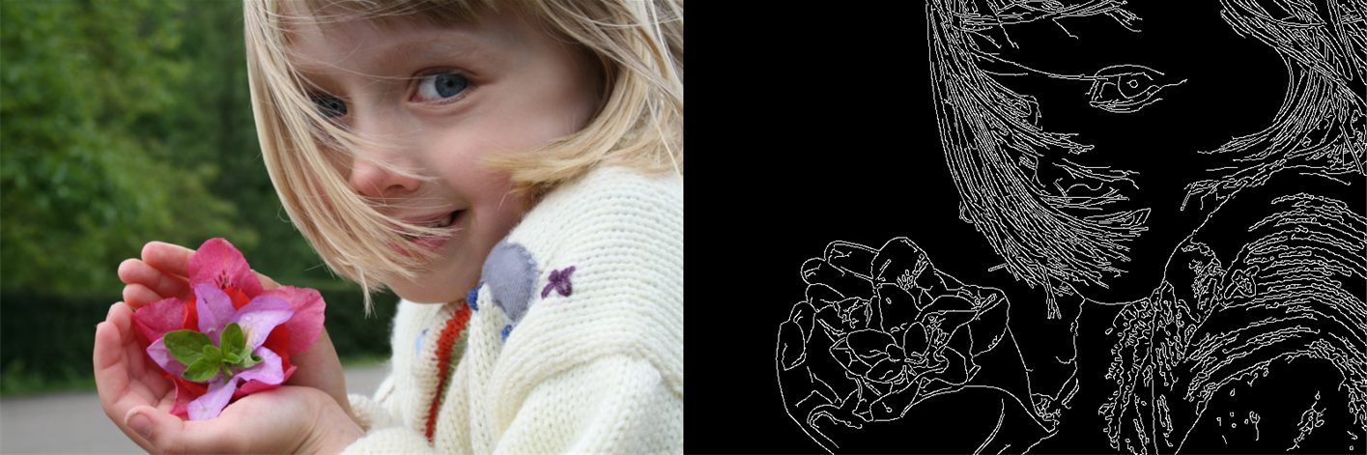

Example Convolutions: Moving Average, Edge Detector
Moving Average
Edge
Detector
$$∗$$
Tinos, CC-SA 3.0,
https://commons.wikimedia.org/wiki/
File:Convolution_of_box_signal_with_itself2.gif
Sfdodge, CC-By 4.0,
https://commons.wikimedia.org/
wiki/File:Time-domain.png
Jon McLoone, CC-SA 3.0,https://commons.wikimedia.org/wiki/File:%C3%84%C3%A4retuvastuse_n%C3%A4ide.png

Slide 13
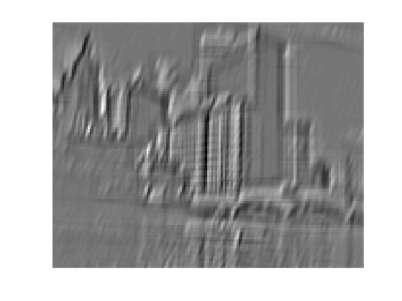
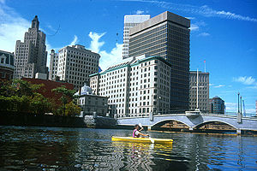
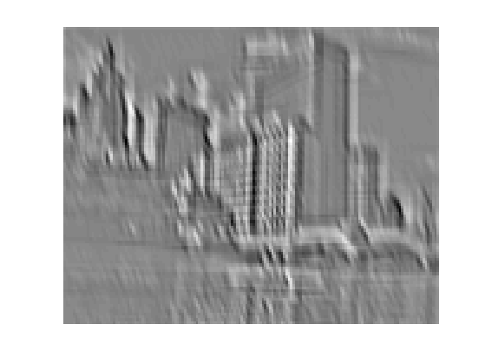
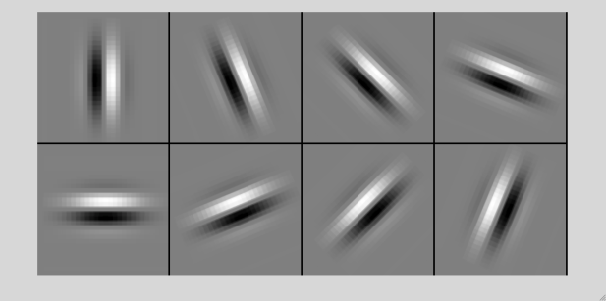
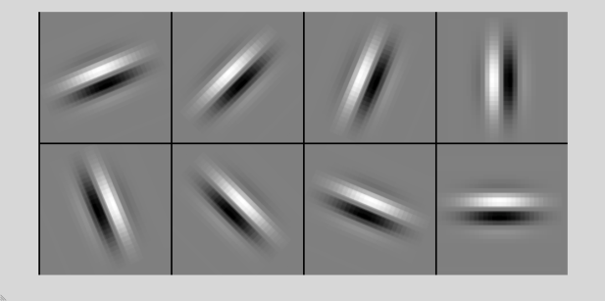
What is a convolution?
Weighted moving average
All positive weights: average
Some weights negative: finds edges, corners, etc.
...
Input
Output Channels (edges with different orientations)

Slide 14
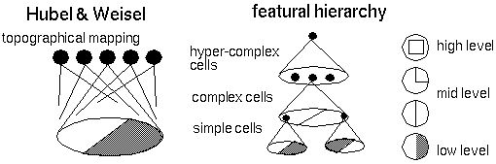
Biological inspiration
D. Hubel and T. Wiesel (1959, 1962, Nobel Prize 1981)
Visual cortex consists of a hierarchy of simple, complex, and hyper-complex cells
Source

Slide 15
21.3.1 Pooling and downsampling
A pooling layer in a neural network summarizes a set of adjacent units from the preceding layer with a single value.
Pooling works just like a convolution layer, with a kernel size l and stride s , but the operation that is applied is fixed rather than learned. Typically, no activation function is associated with the pooling layer.
There are two common forms of pooling: Average-pooling and Max-pooling
Notes:
other (Figure 21.1(a) ). This significantly limits the expressive power of such models. They can represent only linear functions and boundaries in the input space, whereas most real-world concepts are far more complex.

Slide 16
Average-pooling
Average-pooling computes the average value of its l inputs. This is identical to convolution with a uniform kernel vector k = [1/l, ... ,1/l] . If we set l = s, the effect is to coarsen the resolution of the image—to downsample it—by a factor of s. An object that occupied, say, 10s pixels would now occupy only 10 pixels after pooling.
The same learned classifier that would be able to recognize the object at a size of 10 pixels in the original image would now be able to recognize that object in the pooled image, even if it was too big to recognize in the original image.
Average-pooling facilitates multiscale recognition. It also reduces the number of weights required in subsequent layers, leading to lower computational cost and possibly faster learning.
Notes:
other (Figure 21.1(a) ). This significantly limits the expressive power of such models. They can represent only linear functions and boundaries in the input space, whereas most real-world concepts are far more complex.

Slide 17
21.3.1 Max-pooling
Max-pooling computes the maximum value of its l inputs. It can also be used purely for downsampling, but it has a somewhat different semantics. Suppose we applied max- pooling to the hidden layer [5,9,4] in the result would be a 9, indicating that somewhere in the input image there is a darker dot that is detected by the kernel.
In other words, max-pooling acts as a kind of logical disjunction, saying that a feature exists somewhere in the unit’s receptive field.
Notes:
other (Figure 21.1(a) ). This significantly limits the expressive power of such models. They can represent only linear functions and boundaries in the input space, whereas most real-world concepts are far more complex.

Slide 18
Convolutional Neural Networks
Neural network with specialized connectivity structure
Stack multiple stages of feature extractors
Higher stages compute more global, more invariant features
Classification layer at the end
Y. LeCun, L. Bottou, Y. Bengio, and P. Haffner, Gradient-based learning applied to document recognition, Proc. IEEE 86(11): 2278–2324, 1998.

Slide 19
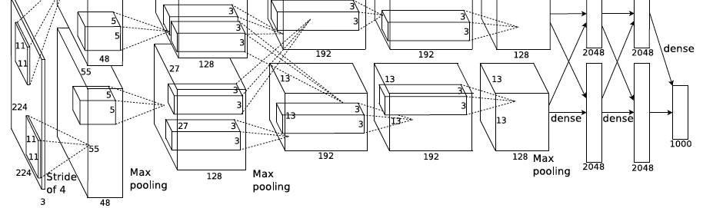
AlexNet
Similar framework to LeCun’98 but:
Bigger model (7 hidden layers, 650,000 units, 60,000,000 params)
More data (10⁶ vs. 10³ images)
GPU implementation (50x speedup over CPU)
Trained on two GPUs for a week
A. Krizhevsky, I. Sutskever, and G. Hinton, ImageNet Classification with Deep Convolutional Neural Networks, NIPS 2012
Notes:
Two-GPU architecture

Slide 20
ImageNet Challenge
~14 million labeled images, 20k classes
Images gathered from Internet
Human labels via Amazon MTurk
Challenge: 1.2 million training images, 1000 classes
[Deng et al. CVPR 2009]
A. Krizhevsky, I. Sutskever, and G. Hinton, ImageNet Classification with Deep Convolutional Neural Networks, NIPS 2012

